Slide 1
Applications of Pumping Lemma
V.Vijayarajan
SCSE, VIT University
Vellore

Slide 2









The Pumping Lemma:
Given a infinite regular language
there exists an integer
for any string with length
we can write
with and
such that:

Slide 3
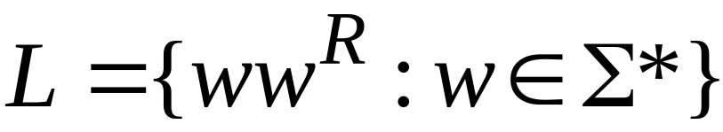
Non-regular languages
Regular languages

Slide 4

Theorem:
The language
is not regular
Proof:
Use the Pumping Lemma

Slide 5
Assume for contradiction
that is a regular language
Since is infinite
we can apply the Pumping Lemma

Slide 6


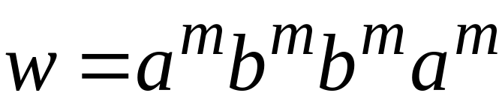
Let be the integer in the Pumping Lemma
Pick a string such that:
length
pick

Slide 7
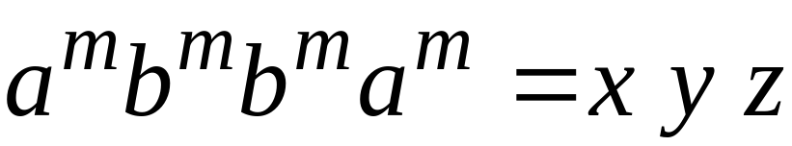




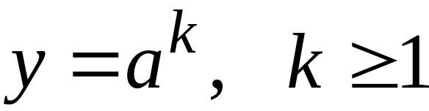
Write
From the Pumping Lemma
it must be that length

Slide 8
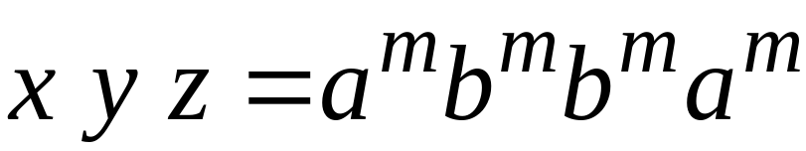

We have:
From the Pumping Lemma:
Thus:

Slide 9
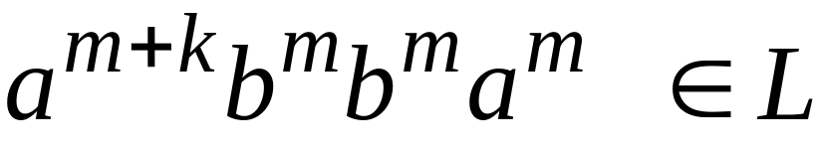
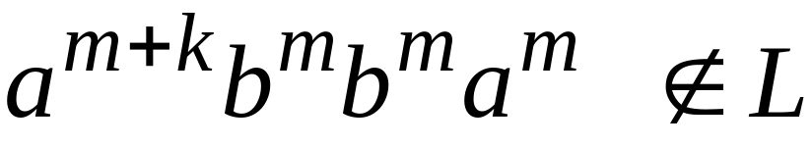
Therefore:
BUT:
CONTRADICTION!!!

Slide 10
Therefore:
Our assumption that
is a regular language is not true
Conclusion:
is not a regular language

Slide 11

Non-regular languages
Regular languages

Slide 12
Theorem:
The language
is not regular
Proof:
Use the Pumping Lemma

Slide 13
Assume for contradiction
that is a regular language
Since is infinite
we can apply the Pumping Lemma

Slide 14
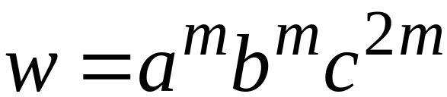
Let be the integer in the Pumping Lemma
Pick a string such that:
length
pick

Slide 15
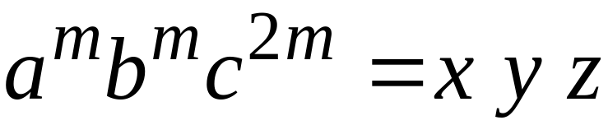

Write
From the Pumping Lemma
it must be that length

Slide 16
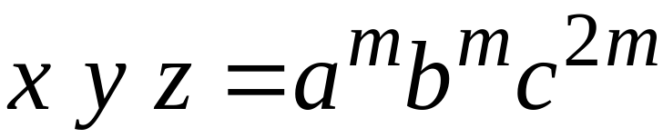
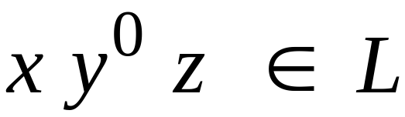
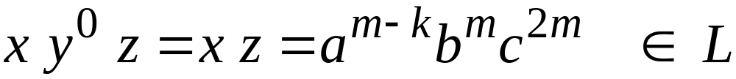
We have:
From the Pumping Lemma:
Thus:

Slide 17
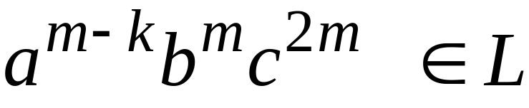
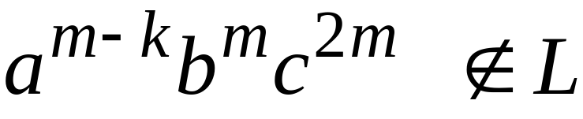
Therefore:
BUT:
CONTRADICTION!!!

Slide 18
Therefore:
Our assumption that
is a regular language is not true
Conclusion:
is not a regular language

Slide 19
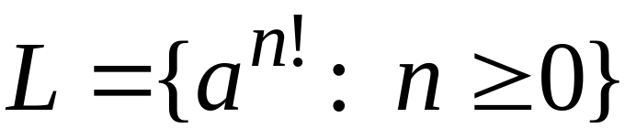
Non-regular languages
Regular languages

Slide 20
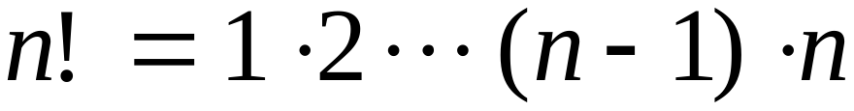
Theorem:
The language
is not regular
Proof:
Use the Pumping Lemma

Slide 21
Assume for contradiction
that is a regular language
Since is infinite
we can apply the Pumping Lemma

Slide 22
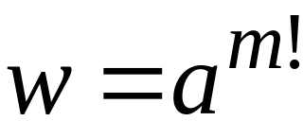
Let be the integer in the Pumping Lemma
Pick a string such that:
length
pick

Slide 23
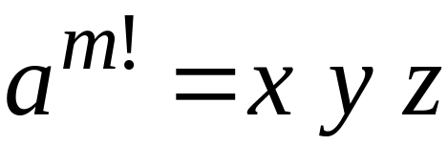

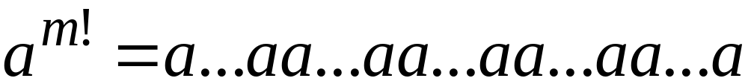
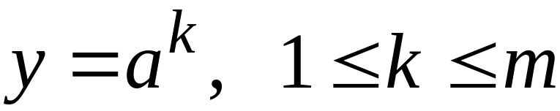
Write
From the Pumping Lemma
it must be that length

Slide 24
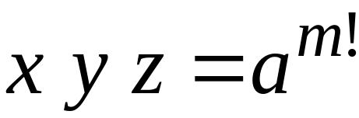
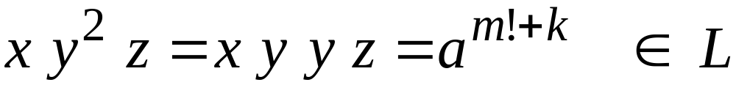
We have:
From the Pumping Lemma:
Thus:

Slide 25
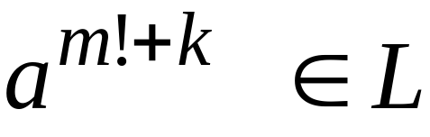
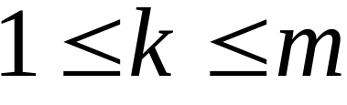

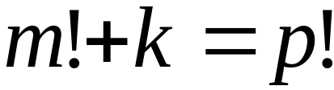
Therefore:
And since:
There is :

Slide 26

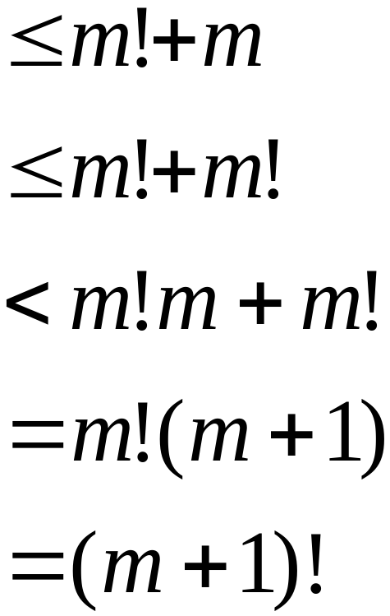

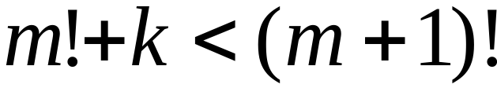
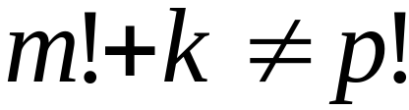
However:
for
for any

Slide 27
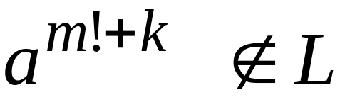
Therefore:
BUT:
and
CONTRADICTION!!!

Slide 28
Therefore:
Our assumption that
is a regular language is not true
Conclusion:
is not a regular language

Slide 29
Lex

Slide 30
Lex: a lexical analyzer
A Lex program recognizes strings
For each kind of string found
the lex program takes an action

Slide 31
Output
Identifier: Var
Operand: =
Integer: 12
Operand: +
Integer: 9
Semicolumn: ;
Keyword: if
Parenthesis: (
Identifier: test
....
Input
Var = 12 + 9;
if (test > 20)
temp = 0;
else
while (a < 20)
temp++;
Lex
program

Slide 32
In Lex strings are described
with regular expressions
Lex program
Regular expressions
“+”
“-”
“=“
/* operators */
“if”
“then”
/* keywords */

Slide 33
Lex program
Regular expressions
(0|1|2|3|4|5|6|7|8|9)+
/* integers */
(a|b|..|z|A|B|...|Z)+
/* identifiers */

Slide 34
integers
(0|1|2|3|4|5|6|7|8|9)+
[0-9]+

Slide 35
identifiers
(a|b|..|z|A|B|...|Z)+
[a-zA-Z]+

Slide 36
Each regular expression
has an associated action (in C code)
Examples:
Regular expression
Action
\n
linenum++;
[0-9]+
prinf(“integer”);
[a-zA-Z]+
printf(“identifier”);

Slide 37
Default action: ECHO;
Prints the string identified
to the output

Slide 38
A small program
%%
[ \t\n] ; /*skip spaces*/
[0-9]+
printf(“Integer\n”);
[a-zA-Z]+
printf(“Identifier\n”);

Slide 39
Output
Input
Integer
Identifier
Identifier
Integer
Integer
Integer
1234 test
var 566 78
9800

Slide 40
%{
int linenum = 1;
%}
Another program
%%
[ \t] ; /*skip spaces*/
\n
linenum++;
[0-9]+
prinf(“Integer\n”);
[a-zA-Z]+
printf(“Identifier\n”);
.
printf(“Error in line: %d\n”,
linenum);

Slide 41
Output
Input
Integer
Identifier
Identifier
Integer
Integer
Integer
Error in line: 3
Identifier
1234 test
var 566 78
9800 +
temp

Slide 42
Lex matches the longest input string
Example:
Regular Expressions
“if”
“ifend”
Input:
ifend if ifn
Matches: “ifend” “if” nomatch

Slide 43
Internal Structure of Lex
Lex
Regular
expressions
Minimal
DFA
NFA
DFA
The final states of the DFA are
associated with actions

